Slide 1
OSI Data Link Layer
Network Fundamentals – Chapter 7

Slide 2
Objectives
Explain the role of Data Link layer protocols in data transmission.
Describe how the Data Link layer prepares data for transmission on network media.
Describe the different types of media access control methods.
Identify several common logical network topologies and describe how the logical topology determines the media access control method for that network.
Explain the purpose of encapsulating packets into frames to facilitate media access.
Describe the Layer 2 frame structure and identify generic fields.
Explain the role of key frame header and trailer fields including addressing, QoS, type of protocol and Frame Check Sequence.

Slide 3
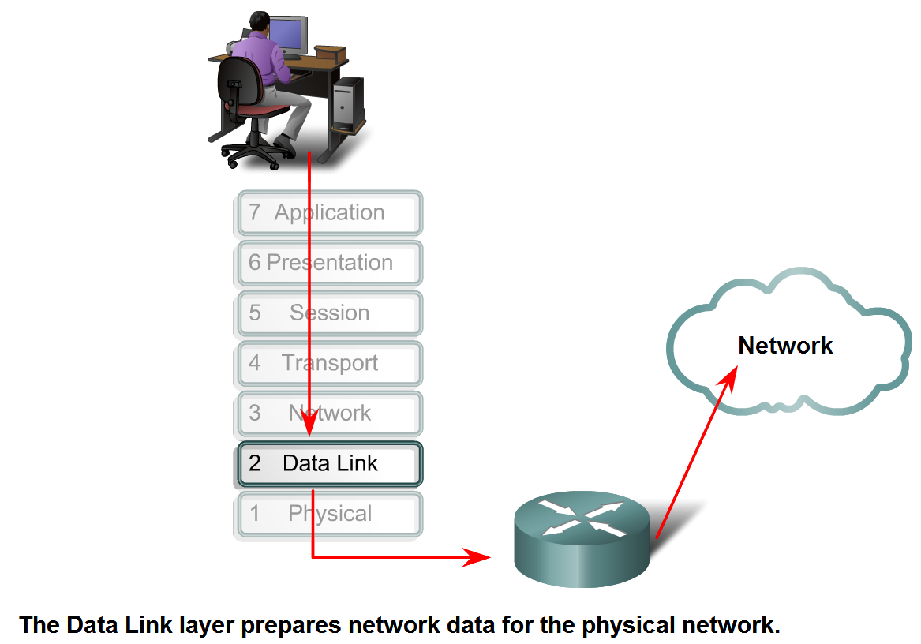
Data Link Layer – Accessing the Media
Describe the service the Data Link Layer provides as it prepares communication for transmission on specific media

Slide 4
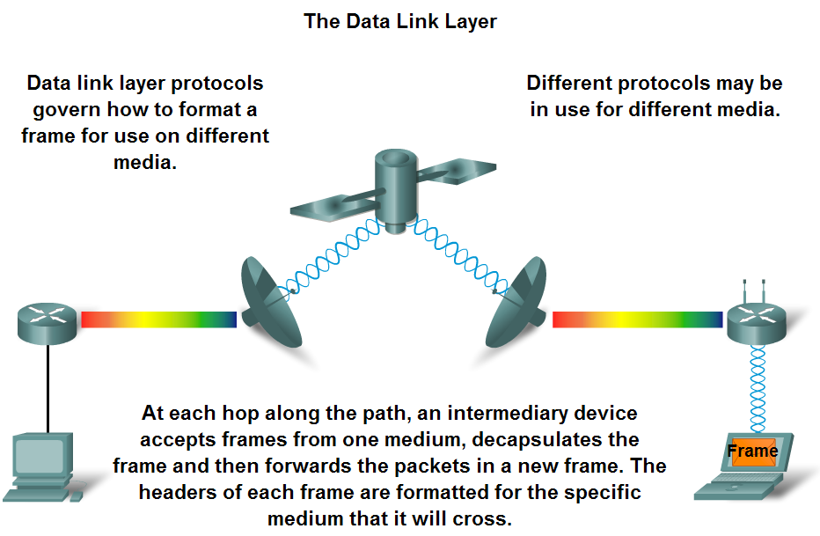
Data Link Layer – Accessing the Media
Describe why Data Link layer protocols are required to control media access

Slide 5
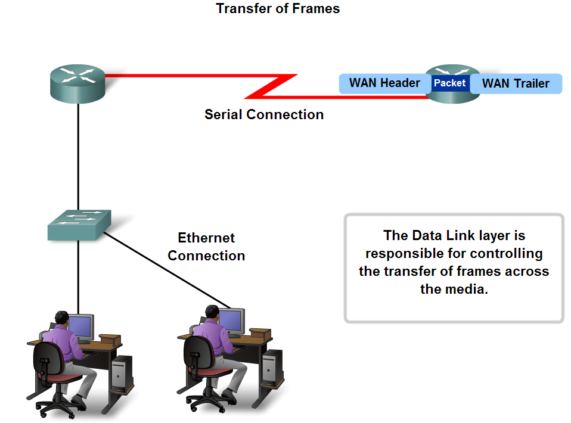
Data Link Layer – Accessing the Media
Describe the role of framing in preparing a packet for transmission on a given media

Slide 6
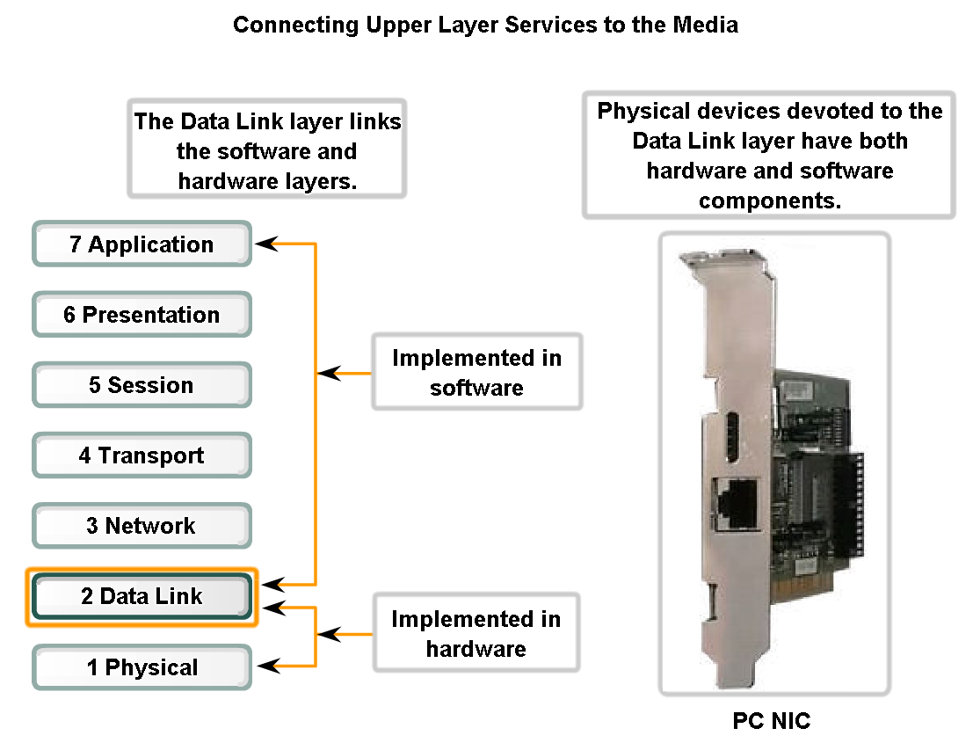
Data Link Layer – Accessing the Media
Describe the role the Data Link layer plays in linking the software and hardware layers

Slide 7
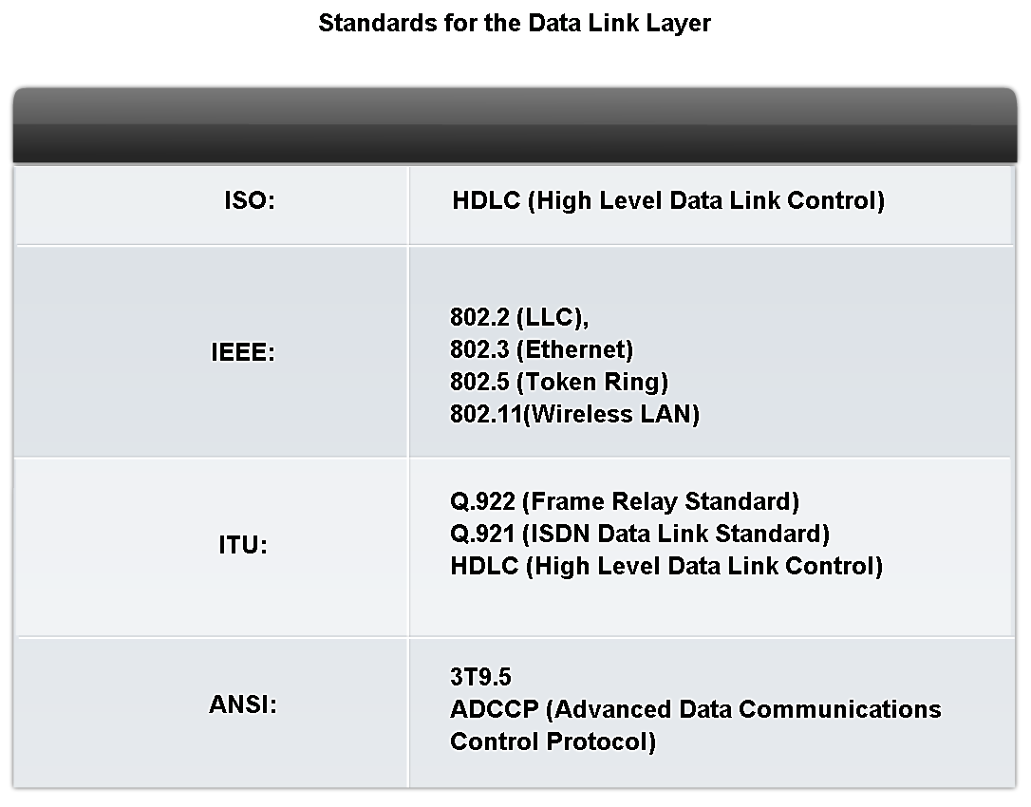
Data Link Layer – Accessing the Media
Identify several sources for the protocols and standards used by the Data Link layer

Slide 8
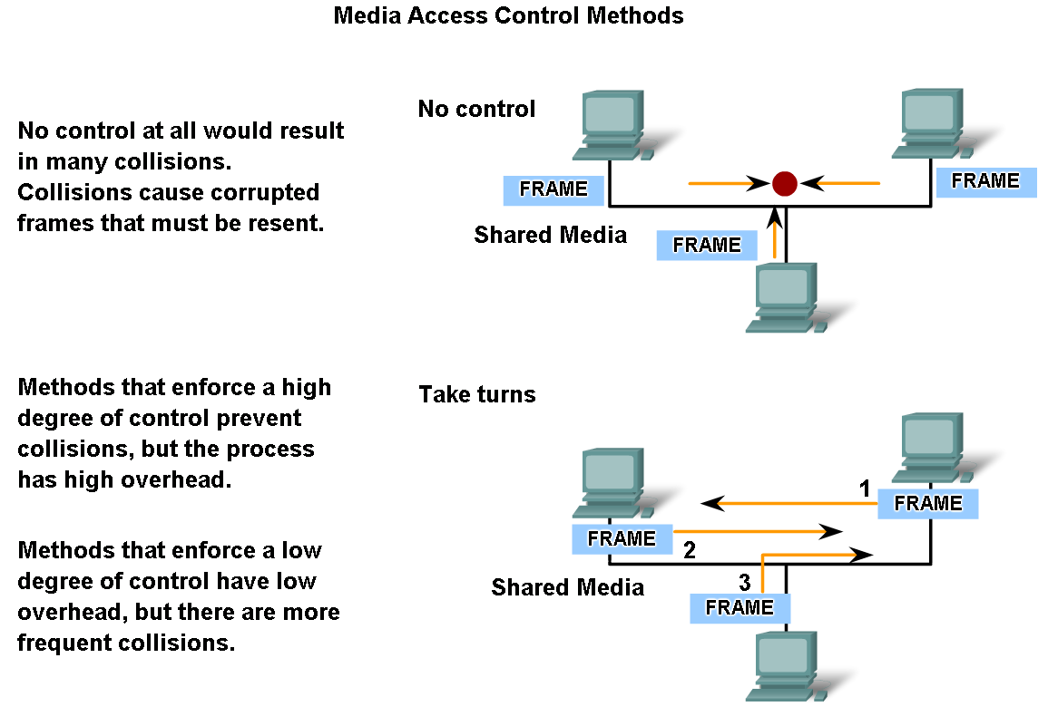
Media Access Control Techniques
Explain the necessity for controlling access to the media

Slide 9
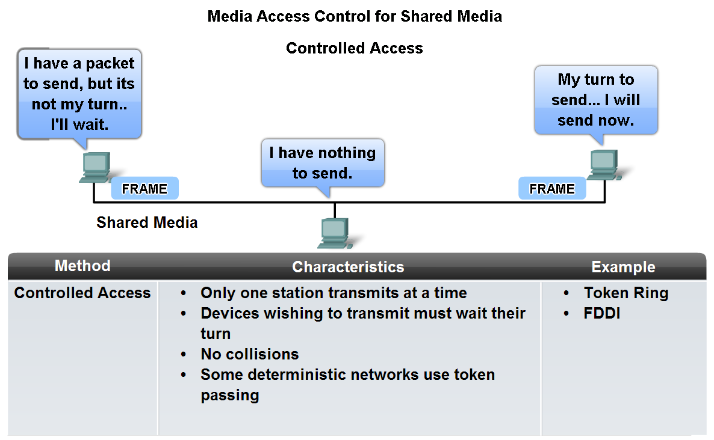
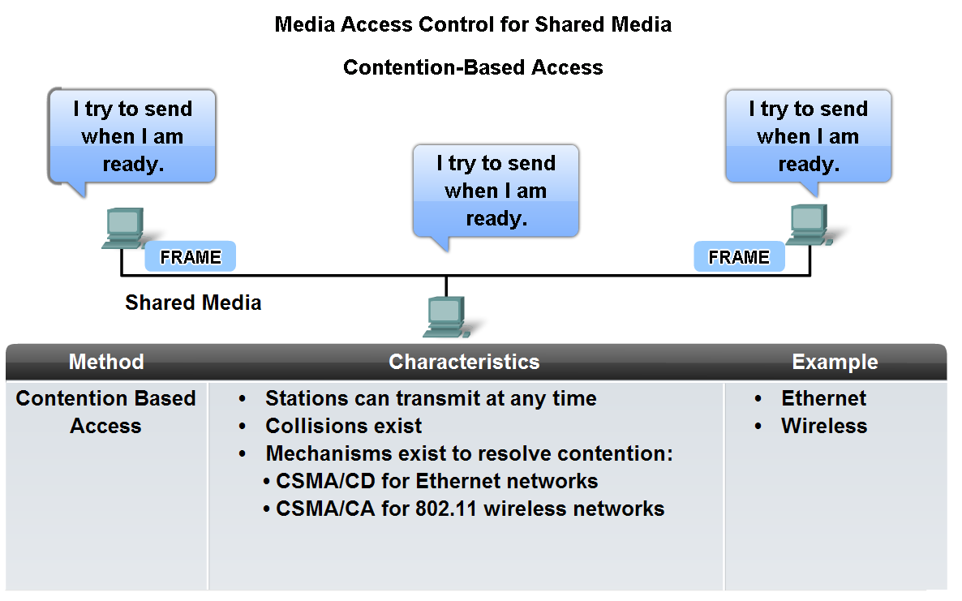
Media Access Control Techniques
Identify two media access control methods for shared media and the basic characteristics of each

Slide 10
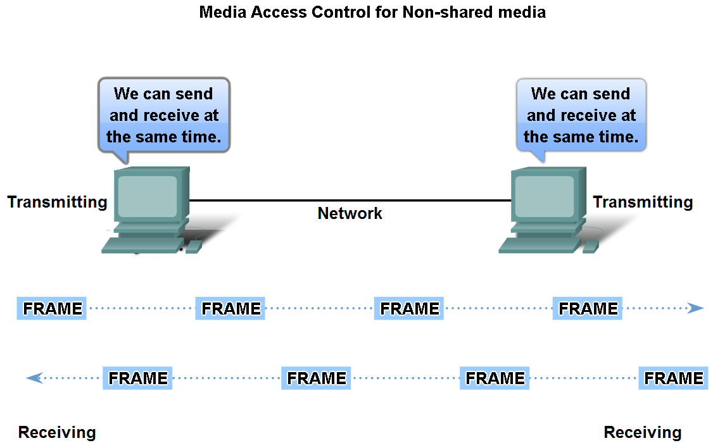
Media Access Control Techniques
Define Full Duplex and Half Duplex as it relates to Media Access Control for non-shared media

Slide 11
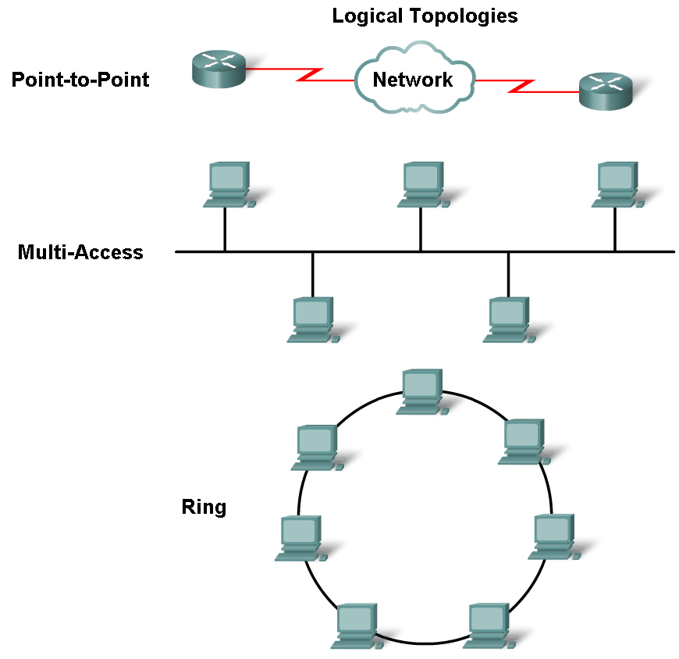
Media Access Control Techniques
Describe the purpose of a logical topology and identify several common logical topologies

Slide 12
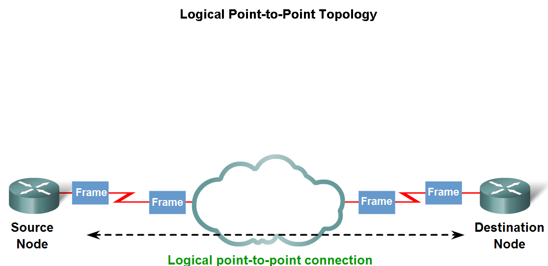
Media Access Control Techniques
Contrast logical and physical topologies

Slide 13
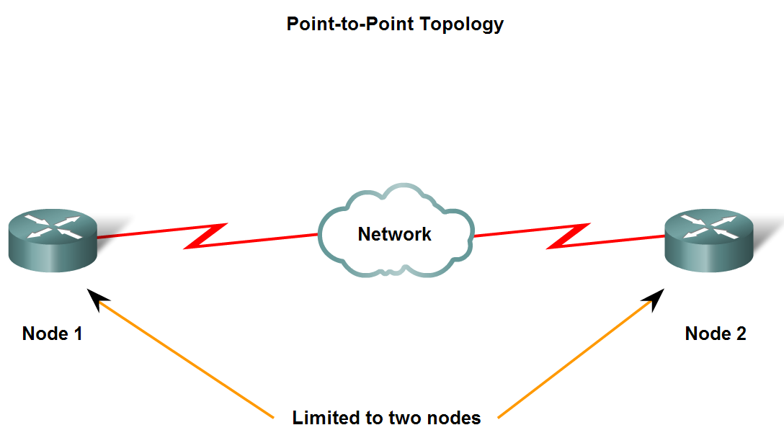
Media Access Control Techniques
Identify the characteristics of point-to-point topology and describe the implications for media access when using this topology

Slide 14
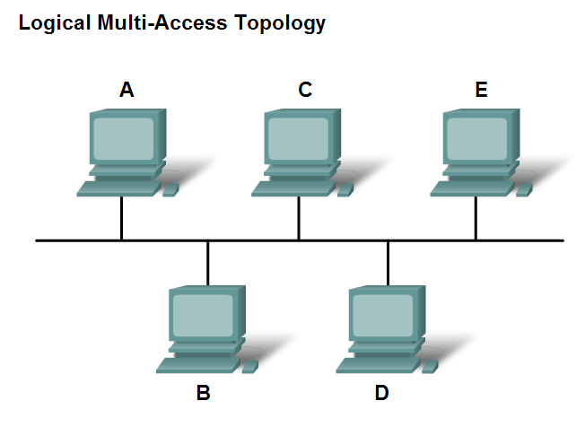
Media Access Control Techniques
Identify the characteristics of multi-access topology and describe the implications for media access when using this topology

Slide 15
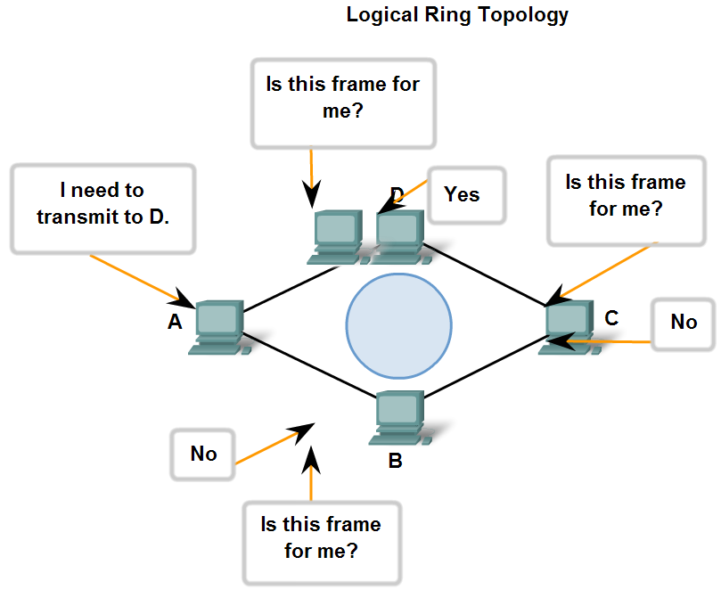
Media Access Control Techniques
Identify the characteristics of ring topology and describe the implications for media access when using this topology

Slide 16
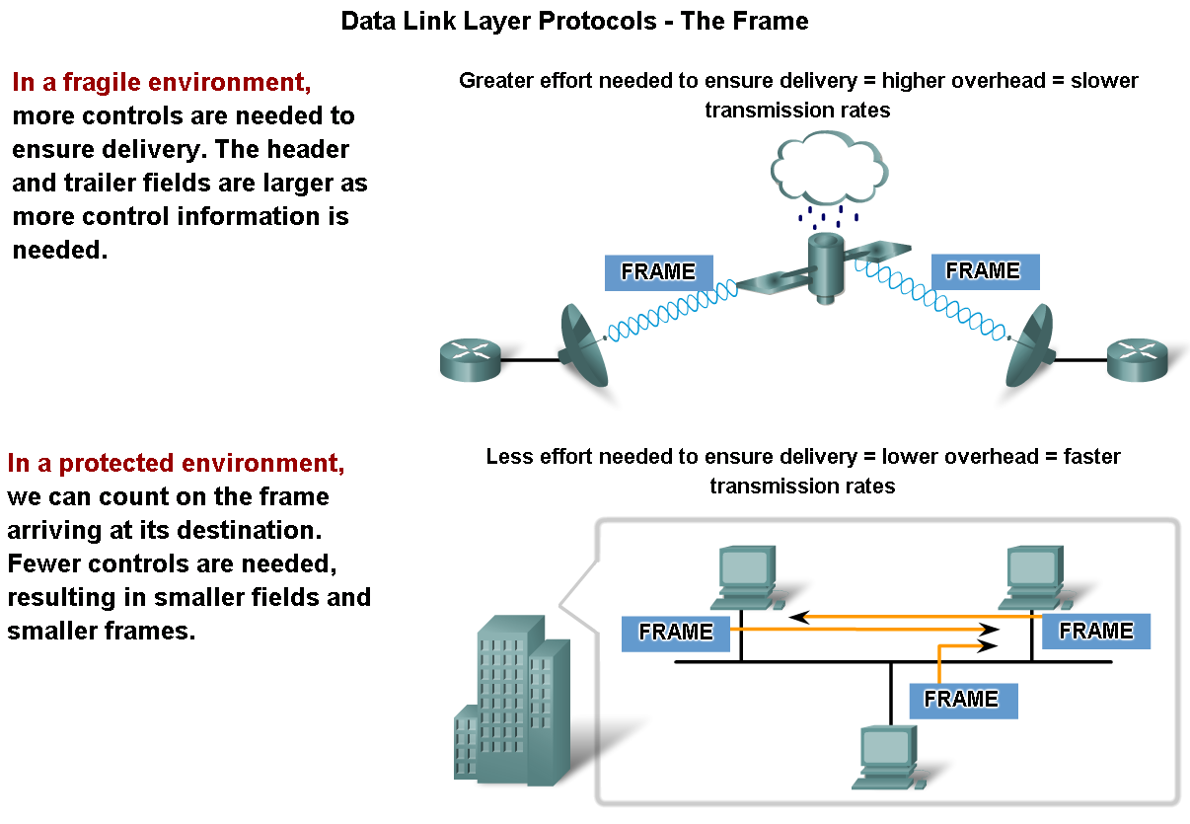
Media Access Control Addressing and Framing Data
Describe the purpose of encapsulating packets into frames to facilitate the entry and exit of data on media

Slide 17
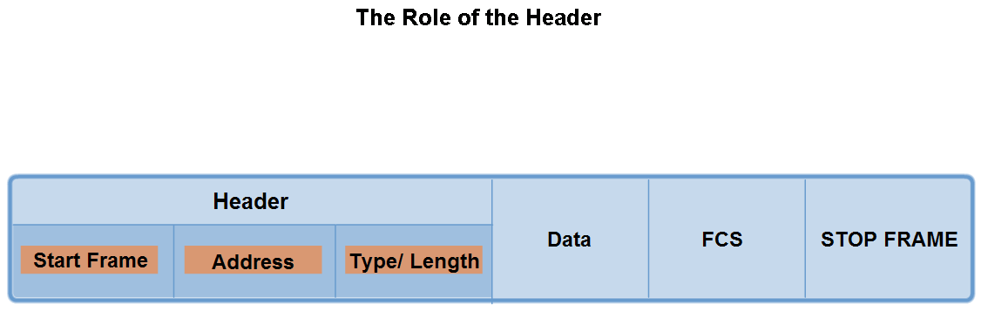
Media Access Control Addressing and Framing Data
Describe the role of the frame header in the Data Link layer and identify the fields commonly found in protocols specifying the header structure

Slide 18
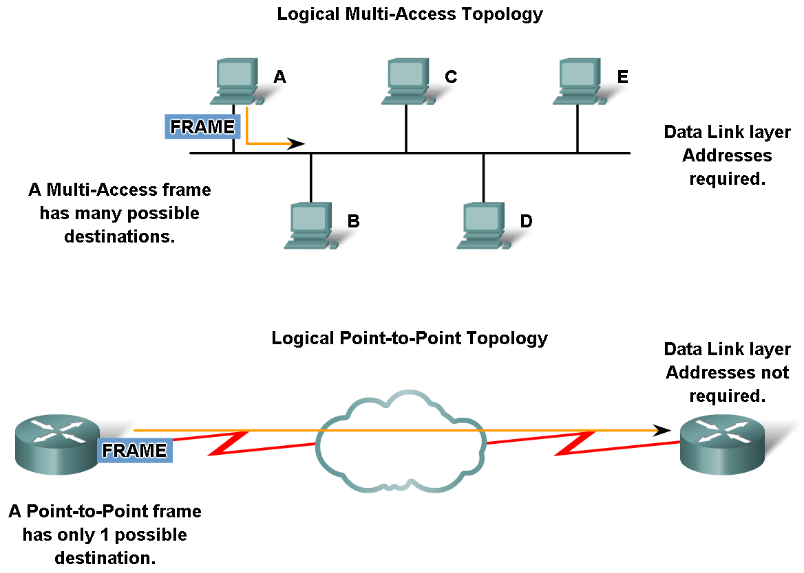
Media Access Control Addressing and Framing Data
Describe the role of addressing in the Data Link layer and identify cases where addresses are needed and cases where addresses are not needed

Slide 19
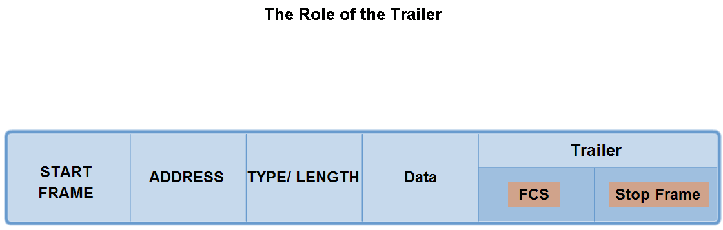
Media Access Control Addressing and Framing Data
Describe the importance of the trailer in the Data Link layer and its implications for use on Ethernet, a "non-reliable" media

Slide 20
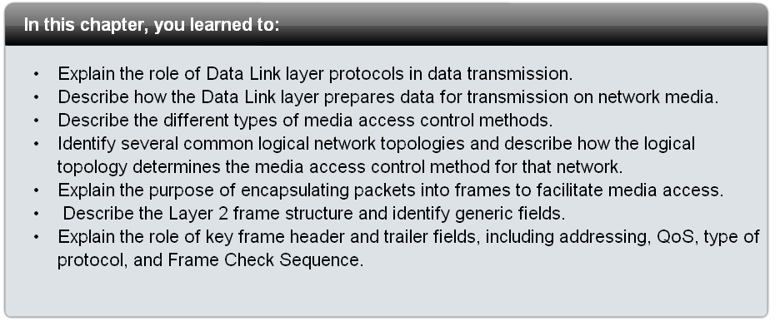
Summary

